Slide 1

Year 1
Information for Parents and Carers

Slide 2
Staff working in Year 1
Mrs Keymer
Class teacher Monday, Tuesday & Wednesday
Miss Fenlon
Class Teacher, Thursday & Friday
Mrs Brown
Teaching Assistant Monday- Friday
Mrs Hackett
Teaching Assistant Monday- Friday
Mrs Vickers
Teaching Assistant Monday- Friday afternoons
PPA Cover (Wednesday PM/Thurs AM)
Mrs Snart (Music)
Mr Troth (PE)
Miss Remnant (Maths)

Slide 3



Worship
Worship will take place every day at 8:50am in the school hall. This will be led by different staff members, as well as representatives from St. Guthlac’s Church.
Merit worships take place on Friday mornings to celebrate individual children’s work and birthday celebrations on Mondays.

Slide 4
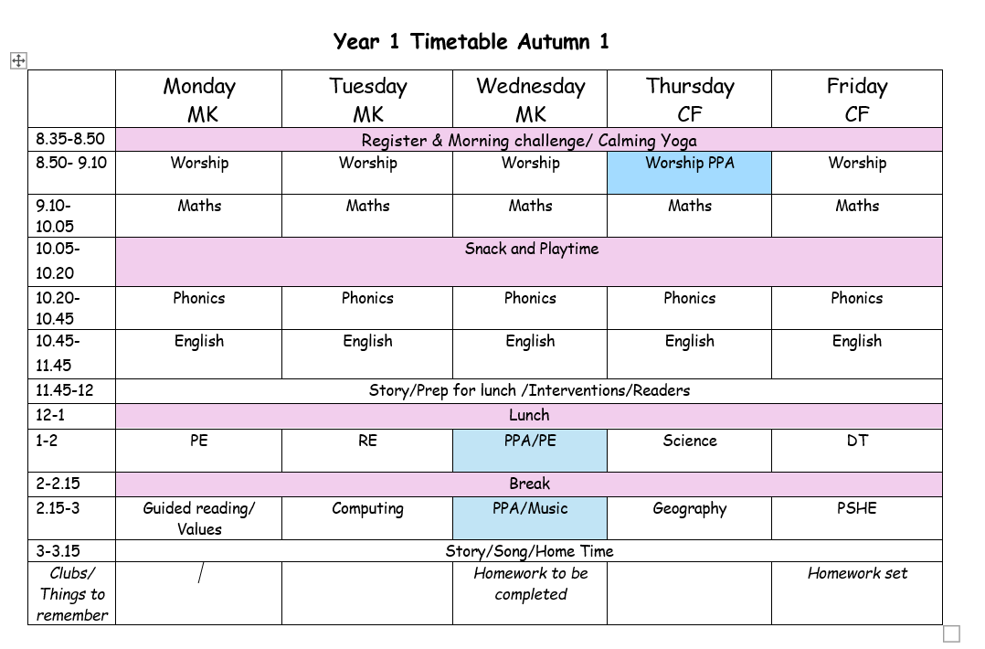
Year 1 Timetable:

Slide 5
What are the themes in Year 1?
Term 1 - Amazing Animals
Term 2 – Terrific Toys
Term 3/4 – Exciting Explorers
Term 5 – Glorious Growing
Term 6 – Super Shanghai

Slide 6
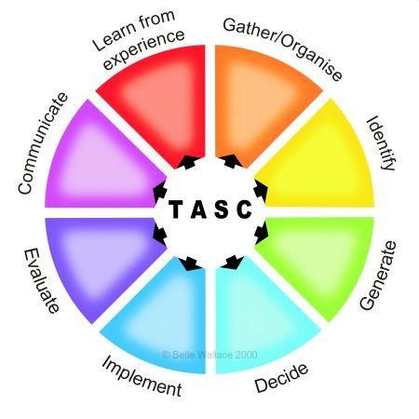
The children will be working on the Year 1 standards in the National Curriculum.
How do we judge how well your children are progressing?
Sharing learning objectives and success criteria together.
Questioning
Partners/Small group work
Self-evaluation
TASC / Using and Applying
Guided groups
Recorded work
Summative assessment
Thinking actively in a social context
Notes:
thinking actively in a social context

Slide 7

Maths
For information on how we are teaching maths in school, please follow the link below.
School website –> Our Learning -> Maths support

Slide 8
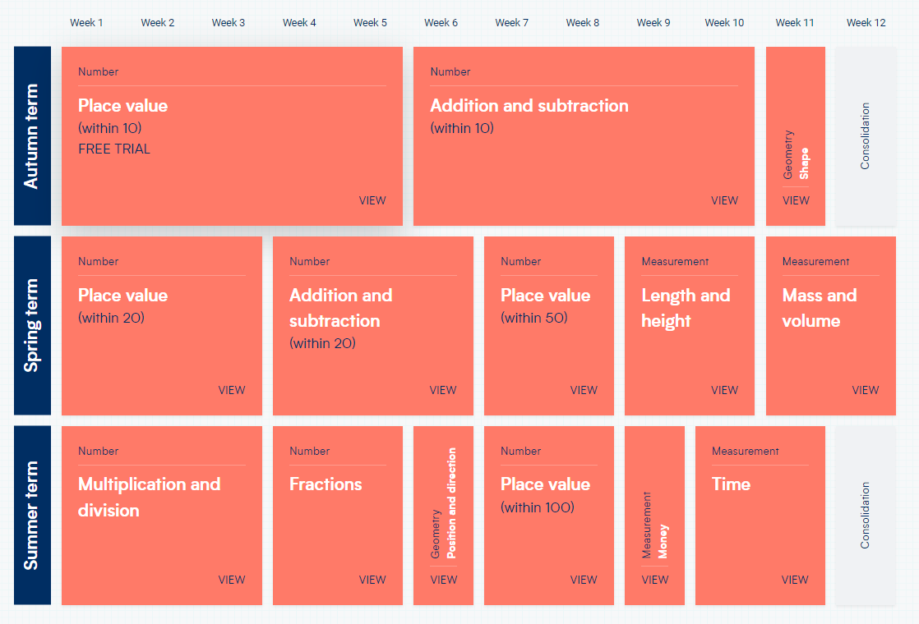
Maths:
These are the areas that the children will work on during Year 1

Slide 9
English:
The sequence of work will begin with looking at the features of the text. Then children will plan their own ideas. They will practise the grammar to be used. Drafting and Editing will then follow. A final piece will be written.
Books and text types we will be sharing over the year to fit in with our topics
Term 1: Giraffes can’t dance, Owl Babies, Monkey Puzzle, Down in the Jungle.
Term 2: Traction Man, Letters to Santa
Term 3:Where the Wild Things Are, Poetry (Seasons- Geography) Shape, poems
Term 4: Recount Diary- Christopher Columbus, The Journey home Setting description, Plot Weave
Term 5: The Tiny seed, instructions on how to grow a plant, Eric Carl- Seed ,Setting description , The extraordinary gardener
Term 6 : Narrative- Plot weave, The Great Race- Chinese Zodiac, Recount- Postcard of trip

Slide 10
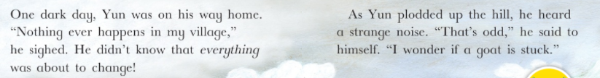
Reading expectations for Year 1
Reading expectations for Year 1
Children should read more fluently.
Children will take the Phonics screen in June 2025 where they will read real and ‘alien’ words. We will be sharing more information on this throughout the year and ways you can support your child at home.

Slide 11
Writing expectations for Year 1
Children will build on previous learning
Punctuation
    capital letters, full stops, question marks and exclamation marks,
Plan, draft and re-draft
Joined handwriting
Use spaces between words in writing.
Use phonics when sounding out words to write.
Use tricky words spelt correctly.
Read through work.
Join sentences in different ways.
Start sentences in different ways.

Slide 12
Geography and History topics
Term 1 – Geography- What is it like here?
Term 2 – History- How have toys changed?
Term 3 – Geography- What’s the weather like here?
Term 4 – History- How am I making history?
Term 5- History- How have explorers changed the world?
Term 6- Geography- What is it like to live in Shanghai?

Slide 13
Homework
Homework will be set online this year via Purple Mash. We have used Purple Mash successfully for remote learning and homework previously and this is a format that the children are used to. Homework will be uploaded to Purple Mash each Friday and should be completed by the following Wednesday.
Homework will be set for all children from Friday 19th September 2025.
Homework will include:
1 x Reading activity on Purple Mash
1 x maths activity on Purple Mash
Reading school reading books. These will be due in on Wednesdays and new books sent home. Tuesdays.

Slide 14

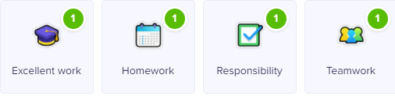

Class Dojo
Children can earn Dojo points for displaying any of the following:
Certificates will be presented if children reach the following milestones:
30 Dojos – Bronze
60 Dojos – Silver
100 Dojos – Gold
150 Dojos - Platinum

Slide 15

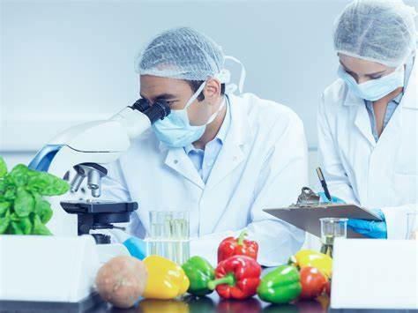
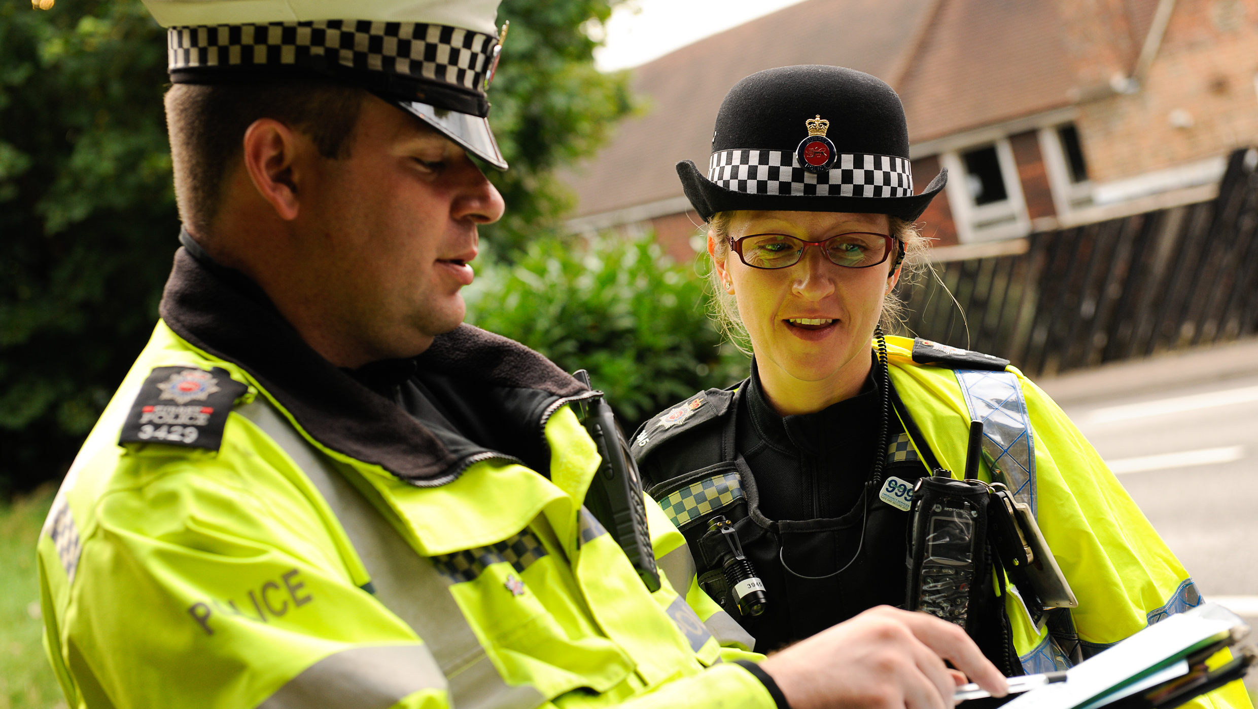
Aspirations
We are very keen to promote and enhance career aspirations for our children. To this end, we are exploring some of the careers that individual subjects could lead to.
Have a look at the booklets that have been produced by subject leaders to introduce the children to some of these careers…

Slide 16
Science
Changes in the seasons including weather
Materials
Animals including humans
Plants and growing
Science investigations will be undertaken on a regular basis. Children will develop skills by:
posing scientific questions,
predicting outcomes,
devising fair tests,
testing
recording results
drawing conclusions.

Slide 17
Key Assessment Dates:
Year 1 Phonics Screening WC 14th June 2026
Year 4 Multiplication Tables Check WC 7th June 2026
Year 6 SATs WC 10th May 2026
Please note that from the 2023/24 academic year, the Key Stage One SATs (Year 2) are no longer statutory.

Slide 18
Collection arrangements
Please let either your child’s class teacher or the school office know of any changes to collection arrangements.
For safeguarding reasons, we cannot let children go home with adults not on collection lists unless you have given us prior notification.
Please note that dogs (except guide dogs) are not permitted on the premises under any circumstances.

Slide 19
Useful Information
PE is on Mondays with Mrs Keymer and Wednesday afternoons with Mr Troth
Please ensure that children come to school in their PE kits on this day.
Please bring a second pair of shoes to school on a Wednesday, which children can change into to wear inside if their trainers get muddy or wet during PE (these can be school shoes or trainers)
Please ensure that hair is tied back and earrings removed on PE days.
Children need to bring their water bottles containing water (not squash) every day.
Please keep big bags to a minimum as we do not have room to store things that do not fit in their lockers.

Slide 20
What can you do to help your child?
Listening to your child read and questioning them about what they have read.
Provide a quiet place and encouragement for homework to be completed.
Use Maths in everyday situations, ask your child to tell you the time, what will it be in …?
Encourage your child to be involved with money when shopping, using the right amount of coins etc.

Slide 21
Remember the school website for additional information.
www.williamhildyard.lincs.sch.uk

Slide 22
We are looking forward to a very positive year ahead. Should you have any questions, please contact the school office via telephone or email and we will arrange a time to contact you.

